Slide 1
Realistic Constraints, Engineering Standards, Modern Engineering Tools for Senior Project: Power Assisted Bicycle
By: Greg Miller & Bradley Joinson
http://powerassistedbicyclekit.weebly.com

Slide 2
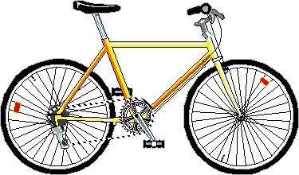
Introduction
Senior Project: Power Assisted Bicycle
Adding an electric motor, and control system to a bicycle to assist riders

Slide 3
Regulations and Code
Classification as “low speed electric bike” Motor Size
(P.L. 2005, CHAPTER 159)
Motor Size
< 750 watts
< 1.5 Brake Horsepower (= 1.5 HP)
Under 100 pounds
Under 20 Mph with motor alone
Registration required depending on state
Power assisted tricycles illegal in New Jersey

Slide 4
Constraints
Economic
Minimize Modification to Bike
Affordable parts
Environmental
Disposal of battery
Sustainability
Common, replaceable parts
Protection from weather and elements

Slide 5
Constraints Cont.
Manufacturability
Set-up on bike minimal and simple so anyone can use.
Using Standard Bicycle Components
Chain
Sprockets

Slide 6
Constraints Cont.
Safety
Protection from motorized parts
Where can this be used safely?
Roads
Sidewalks
Parks
Warnings/restrictions for children

Slide 7
Modern Engineering Tools
Cero Parametric (Pro/E )
Model bike frame
ANSYS
Stress analysis
Affects of the mounting on the frame

